Slide 1
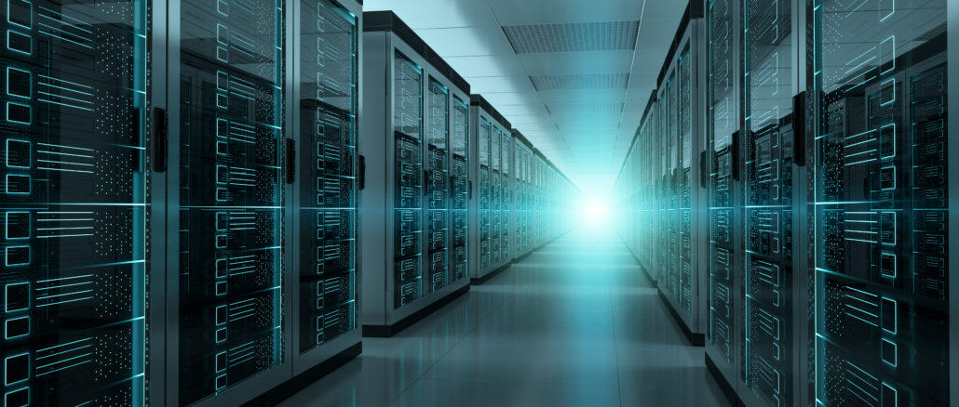
PARALLEL PROGRAMMING...
By Patrick Lemoine 2023

Slide 2

Parallel Programming: Overview
SESSION 1/6
Sequential Parallel Programming
Hardware Architecture
Architecture of a CPU versus GPU
AMD ROCm and CUDA Platforms
GPGPU (General Purpose computation on Graphics Processing Units)
Programming Interface for parallel computing
MPI (Message Passing Interface)
OpenMP (Open Multi-Processing)
GOAL

Slide 3


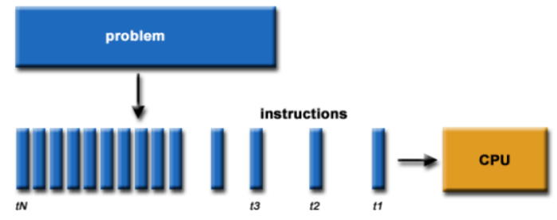
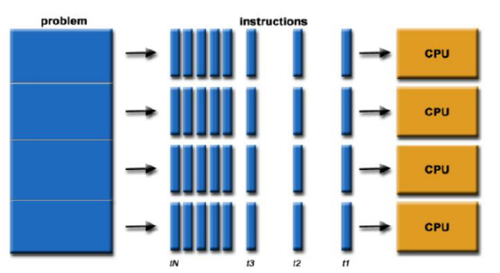
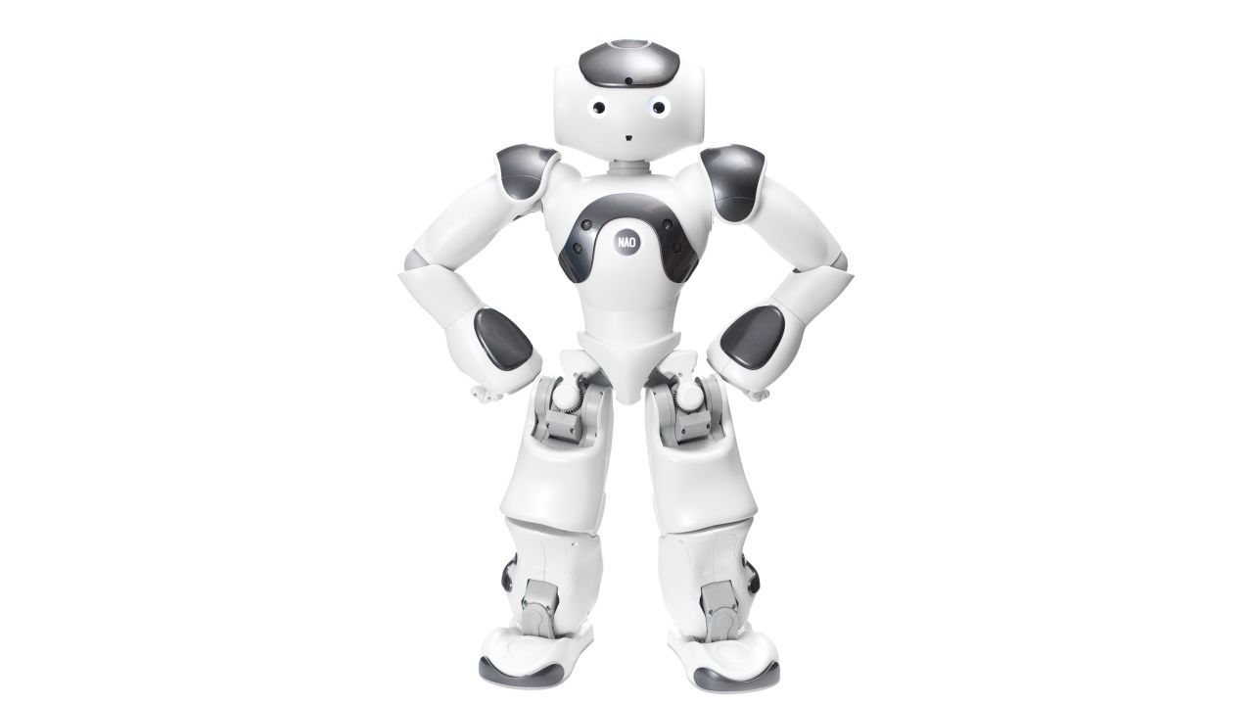
Sequential / Parallel Programming
Traditional Computing:
Programs are broken into series instruction.
Executed by a single processor sequentially.
No coordination required
Parallel programming is the use of several calculation :
Programs are broken co-current subprograms
Executed on multiple processors in parallel
Each party is still discovered in instructions
Coordination required between processors
Instructions of each party are executed in parallel

Slide 4


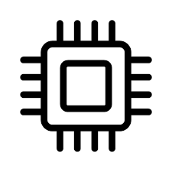
Hardware Architecture

Slide 5
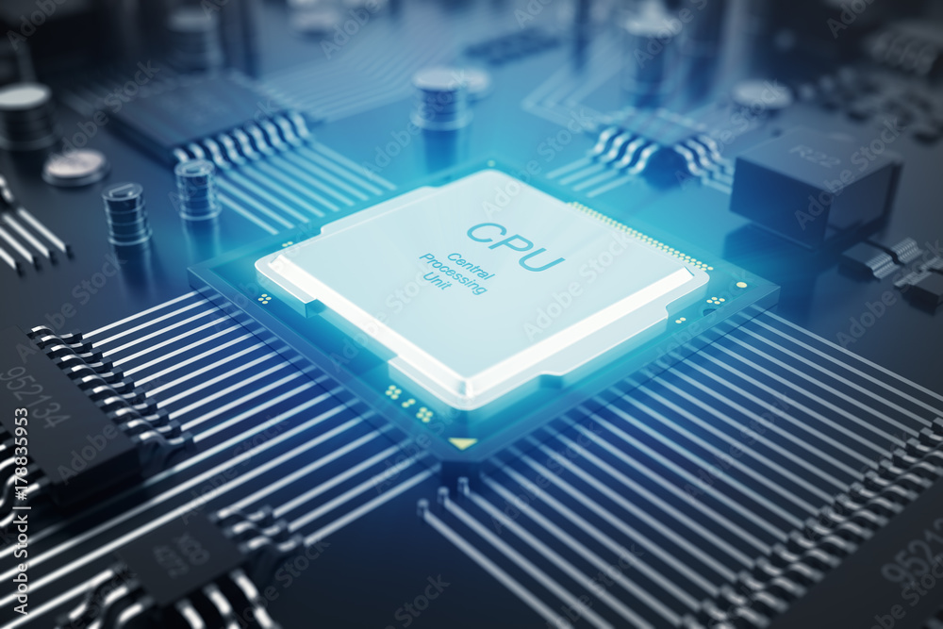
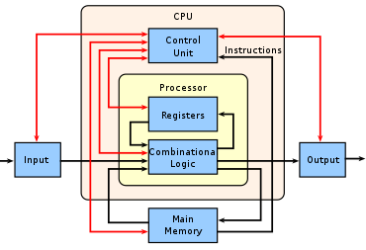

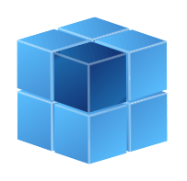
CPU (Central Processing Unit)
A CPU (Central Processing Unit) is the most important processor in a given computer. It executes instructions of a computer program, such as arithmetic, logic, controlling, and input/output (I/O) operations.
It constitutes the physical heart of the entire computer system.
Linked with various peripheral equipment, including input/output devices and auxiliary storage units.

Slide 6
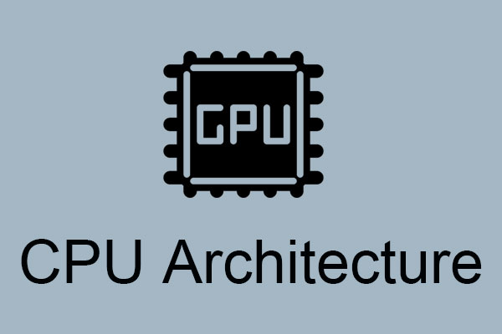
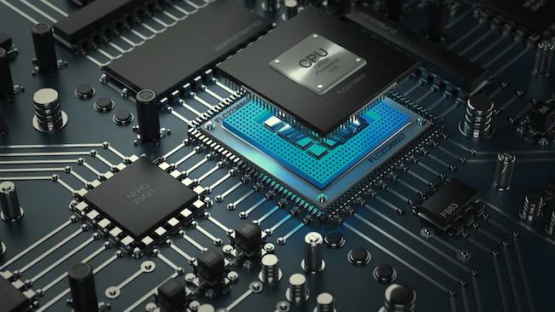
CPU: Different architectures of the processor
There is a classification of the different CPU architectures.
Five in number, they are used by programmers depending on the desired results:
CISC: very complex addressing.
RISC: simpler addressing and instructions performed on a single cycle.
VLIW: long, but simpler instructions.
vectorial: contrary to the processing in number, the instructions are vectorial.
dataflow: data is active unlike other architectures.

Slide 7
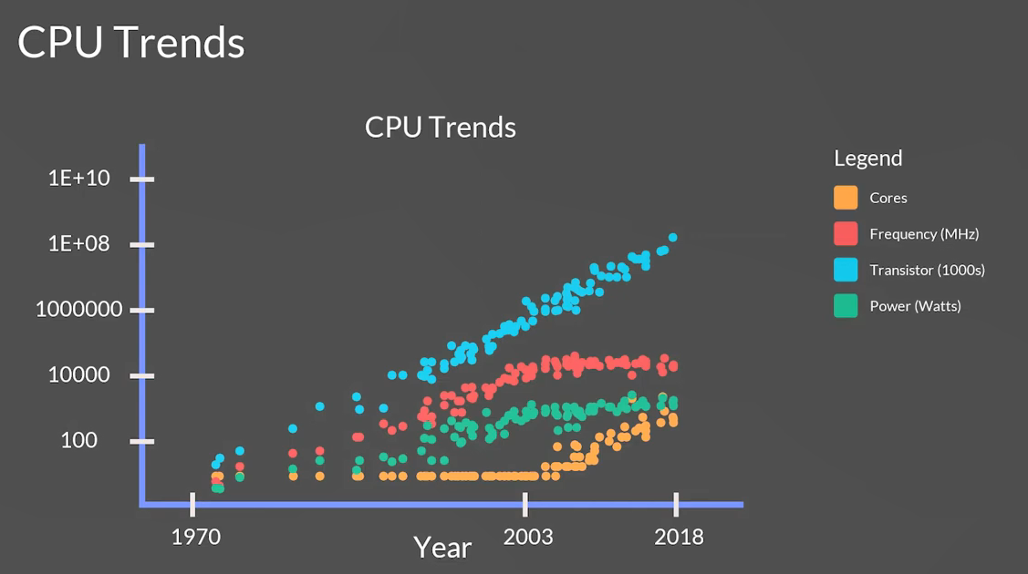
CPU (Central Processing Unit): Trends

Slide 8
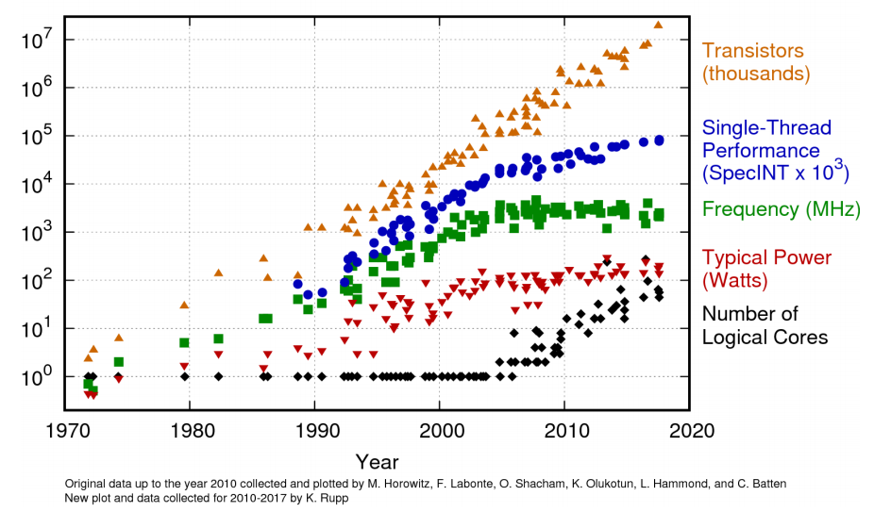
CPU (Central Processing Unit): Trends

Slide 9
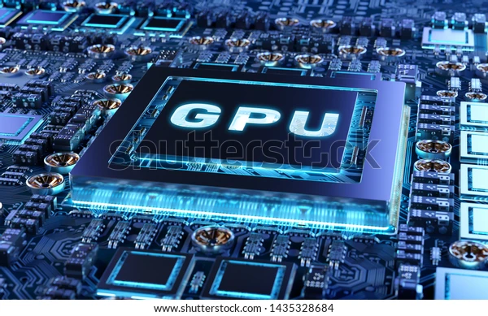
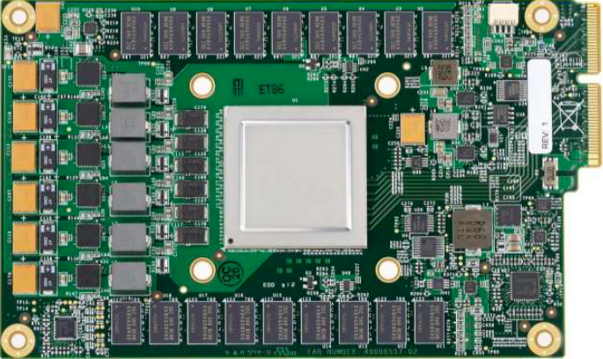
GPU (Graphics Processing Unit)
A GPU is uses to speed up the process of creating and rendering computer graphics, designed to accelerate graphics and image processing.
It is the most important hardware.
But have later been used for non-graphic calculations involving embarrassingly parallel problems due to their parallel structure.

Slide 10
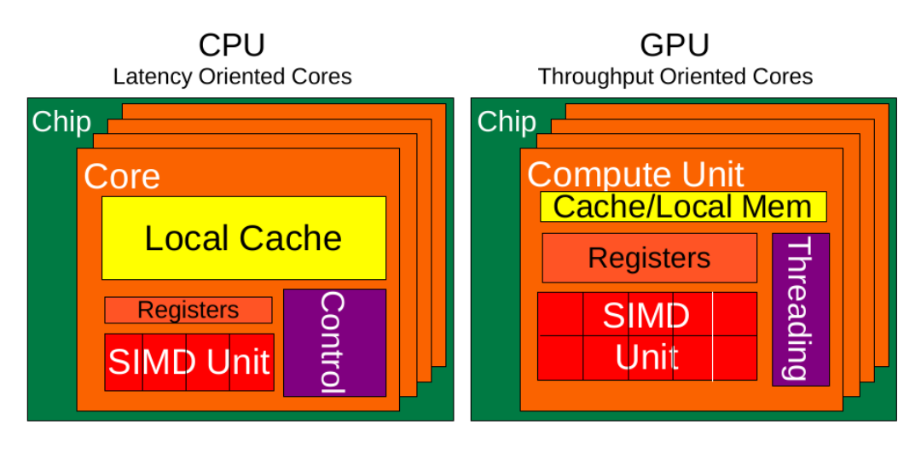
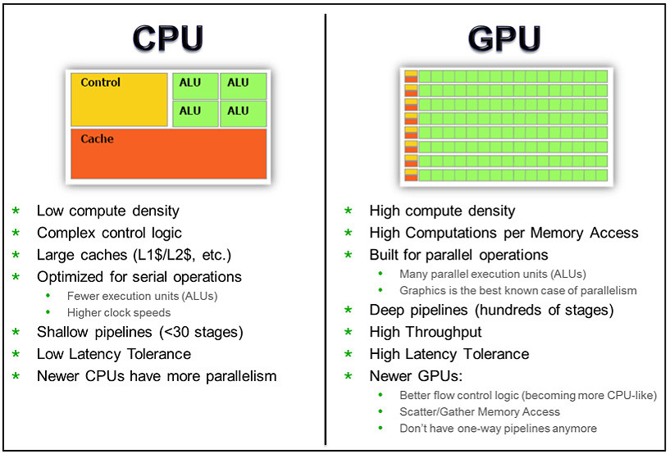
CPU vs GPU
CPU is composed of just a few cores with lots of cache memory that can handle a few software threads at a time.
In contrast, a GPU is composed of hundreds of cores that can handle thousands of threads simultaneously.
GPU is specialized for compute intensive, highly data parallel computation
- More area is dedicated to processing
- Good for high arithmetic intensity programs with a high ratio between arithmetic operations and memory operations.

Slide 11
CPU vs GPU Comparison
 | CPU: Latency-oriented design | GPU: Throughput Oriented Design
Clock | High clock frequency | Moderate clock frequency
Caches | Large sizes Converts high latency accesses in memory to low latency accesses in cache | Small caches To maximize memory throughput
Control | Sophisticated control system Branch prediction to reduce latency due to branching Data loading to reduce latency due to data access | Single controlled No branch prediction No data loading
Powerful Arithmetic Logic Unit (ALU) | Reduced operation latency | Numerous, high latency but heavily pipelined for high throughput
Other aspects | Lots of space devoted to caching and control logic. Multi-level caches used to avoid latency Limited number of registers due to fewer active threads Control logic to reorganize execution, provide ILP, and minimize pipeline hangs | Requires a very large number of threads for latency to be tolerable
Beneficial aspects for applications | CPUs for sequential games where latency is critical. CPUs can be 10+X faster than GPUs for sequential code. | GPUs for parallel parts where throughput is critical. GPUs can be 10+X faster than GPUs for parallel code.

Slide 12
GPU (Graphics Processing Unit)
GPU is the chip in computer video cards, PS3, Xbox, etc
Designed to realize the 3D graphics pipeline
Application → Geometry → Rasterizer→ Image
GPU development:
Fixed graphics hardware
Programmable vertex/pixel shaders
GPGPU
General purpose computation (beyond graphics) using GPU in applications other than 3D graphics
GPGPU can be treated as a co-processor for compute intensive tasks
With sufficient large bandwidth between CPU and GPU.

Slide 13
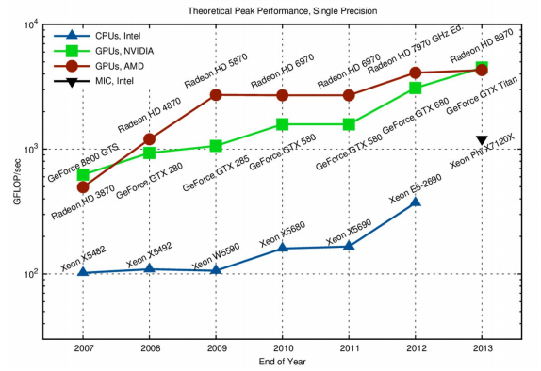
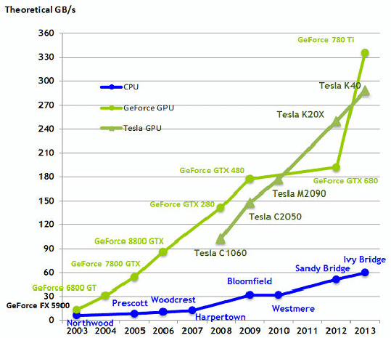
GPU Performance

Slide 14
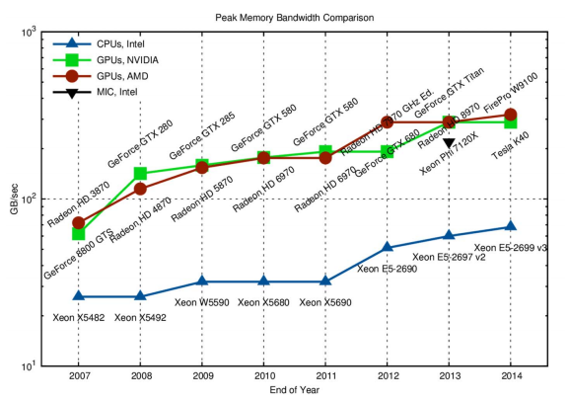

GPU Memory Bandwidth
GPU memory bandwidth is a measure of the data transfer speed between a GPU and the system across a bus, such as PCI Express (PCIe) or Thunderbolt.

Slide 15
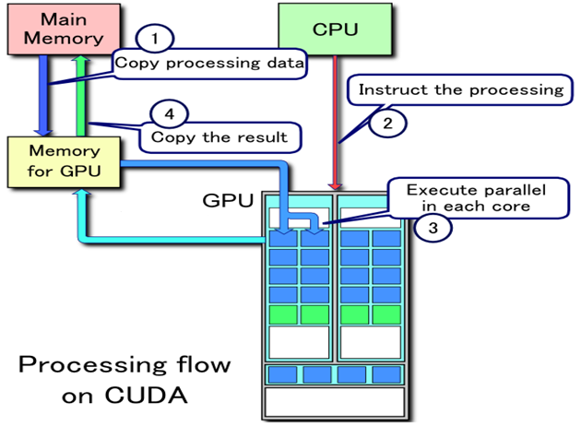
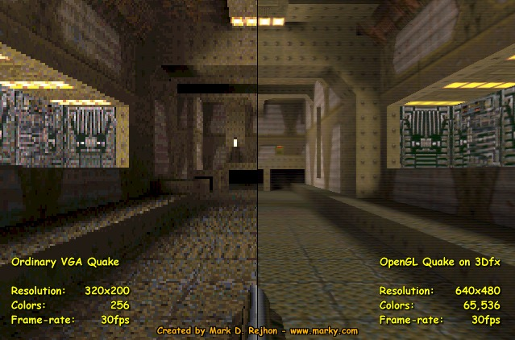
CPU and GPU CONNECTION
The GPU pipeline
GPU receives geometry information from the CPU as an input and provides a picture as an output
host
interface
vertex
processing
triangle
setup
fragment
processing
memory
interface

Slide 16



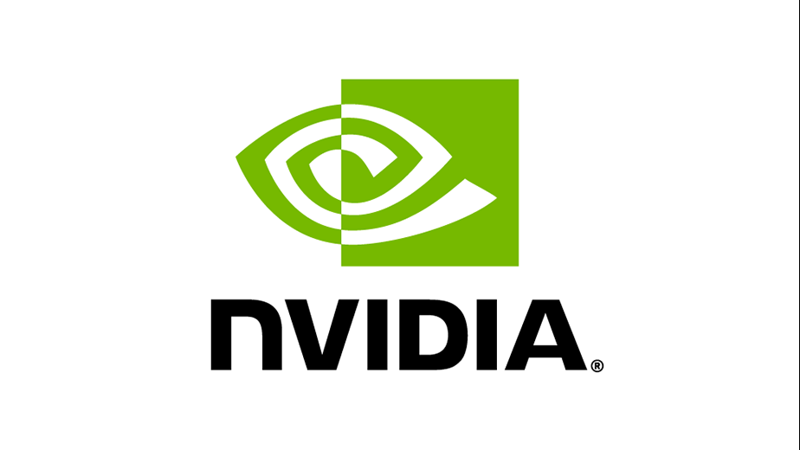
Native GPU code: HIP/CUDA
CUDA from NVIDIA
Has been a standard for native GPU code for years
Extensive set of optimized libraries available
Custom syntax (extension of C++) supported only by CUDA compilers
Support only f or NVIDIA devices
HIP (Heterogeneous-computing Interface for Portability) from AMD
AMD effort to offer a common programming interface that works on both CUDA and ROCm devices
Standard C++ syntax, uses nvcc/hcc compiler in the background
Almost a one-on-one clone of CUDA from the user perspective
Ecosystem is new and developing fast
AMD and NVIDIA offers also a wide set of optimized libraries and tools

Slide 17
GPGPU
General Purpose computation
on Graphics Processing Units.

Slide 18
GPGPU (General-Purpose Graphics Processing Unit)
GPGPU: Using graphic hardware for non-graphic computations
Prefect for massive parallel processing on data paralleled applications
GPU acts as an “accelerator” to the CPU (heterogeneous system)
Most lines of code are executed on the CPU (serial computing)
Key computational kernels are executed on the GPU (stream computing)
Taking advantage of the large number of cores and high graphics memory bandwidth
GPUs now firmly established in HPC industry
Can augment each node of parallel system with GPUs

Slide 19
GPGPU: Programming Considerations
Standard (CPU) code will not run on a GPU unless it is adapted
Programmer must
decompose problem onto the hardware in a specific way (e.g. using a hierarchical thread/grid model in CUDA)
Manage data transfers between the separate CPU and GPU memory spaces.
Traditional language (C, C++, Fortran etc) not enough, need extensions, directives, or new language.
Once code is ported to GPU, optimization work is usually required to tailor it to the hardware and achieve good performance
Many researchers are now successfully exploiting GPUs
Across a wide range of application areas

Slide 20
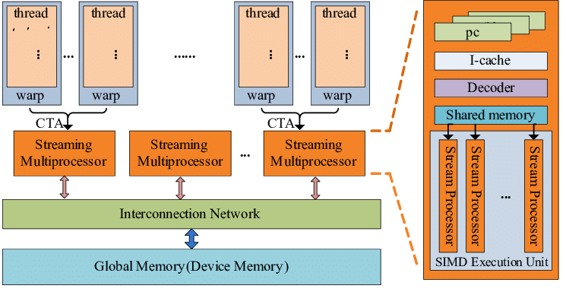
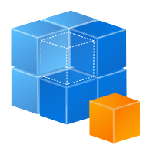
GPGPU (General-Purpose Graphics Processing Unit)
Architecture
A GPGPU is a GPU that is programmed for purposes beyond graphics processing,
such as performing computations typically conducted by a Central Processing Unit (CPU).

Slide 21

GPGPU (General-Purpose Graphics Processing Unit)
Advantages of GPGPU
GPUs have many more cores than CPUs, which allows them to process large amounts of data in parallel. This can result in significant speedups for some problems, especially those involving matrices, vectors, images or graphics.
GPUs can also handle floating point operations more efficiently than CPUs, which is important for scientific computing and machine learning applications.
GPUs can be used to accelerate various domains such as computer vision, natural language processing, cryptography, bioinformatics, physics simulation, etc.

Slide 22

GPGPU (General-Purpose Graphics Processing Unit)
Disadvantages of GPGPU
GPUs are not suitable for all kinds of problems, especially those that require sequential or branching logic, complex data structures, or synchronization among threads.
GPUs have limited memory and bandwidth compared to CPUs, which can limit the amount of data that can be transferred or processed at once.
GPUs require specialized programming languages and APIs to access their features, which can increase the complexity and learning curve for developers.

Slide 23




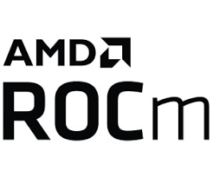
GPGPU Programming Languages and APIs
There are several options for programming GPGPU applications:
CUDA: A proprietary platform developed by Nvidia that allows programmers to write C/C++ code that runs directly on Nvidia GPUs. It also provides libraries and tools for various domains such as linear algebra, image processing, deep learning, etc.
OpenCL: An open standard developed by the Khronos Group that supports multiple platforms and devices, including CPUs, GPUs, FPGAs, etc. It defines a C-like language and a runtime API for executing kernels on heterogeneous devices.
DirectCompute: A Microsoft API that is part of DirectX 11 and 12 that enables GPGPU programming on Windows platforms. It supports HLSL shaders and C++ AMP extensions for writing compute kernels.
Metal: An Apple API that provides low-level access to the GPU on iOS and macOS platforms. It supports Swift and Objective-C languages for writing compute shaders.
Vulkan: A cross-platform API developed by the Khronos Group that provides low-level access to the GPU and other devices. It supports SPIR-V as an intermediate language for writing compute shaders.
ROCm: is an Advanced Micro Devices (AMD) software stack for graphics processing unit (GPU) programming and spans several domains: GPGPU, HPC ,heterogeneous computing

Slide 24
Programming interface for parallel computing
병렬 컴퓨팅을 위한 프로그래밍 인터페이스

Slide 25

Programming Interface
MPI (Message Passing Interface) and
OpenMP (Open Multi-Processing)

Slide 26

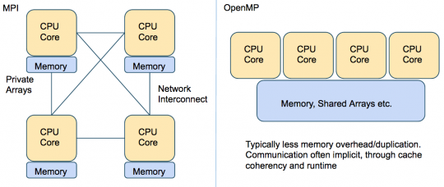
Programming interface MPI, OpenMP
MPI, OpenMP two complementary parallelization models.
MPI (Message Passing Interface) is a multi-process model whose mode of communication between the processes is explicit (communication management is the responsibility of the user).
Generally used on multiprocessor machines with distributed memory.
It is a library for passing messages between processes without sharing.
OpenMP (Open Multi-Processing) is a multitasking model whose mode of communication between tasks is implicit (the management of communications is the responsibility of the compiler).
OpenMP is used on shared-memory multiprocessor machines. It focuses on shared memory paradigms. It is a language extension for expressing data-parallel operations (usually parallelized arrays over loops).

Slide 27
MPI vs OpenMP
MPI | OpenMP
Portable to a distributed and shared memory machine. Scale beyond a node No data placement issues | Easy to implement parallelism Implicit communications Low latency, high bandwidth Dynamic Load Balancing
MPI | OpenMP
Explicit communication High latency, low bandwidth Difficult load balancing | Only on nodes or shared memory machines Scale on Node Data placement problem

Slide 28


Thank you for your attention !

